Slide 1

ANALYSIS PLAN

Slide 2
The analysis plan from our side(Sprocket Central) are being explained in the upcoming slides.
There were specific domains and regions in which the business needs to improve, We have provided the documented orientation via interactive dashboards.
The slides explain:
How the Profits jumps across religions based on the Gender, Category and various other factors.
And, based on the dashboards useful insights driven using some of the BI tools various decisions are taken under consideration.

Slide 3
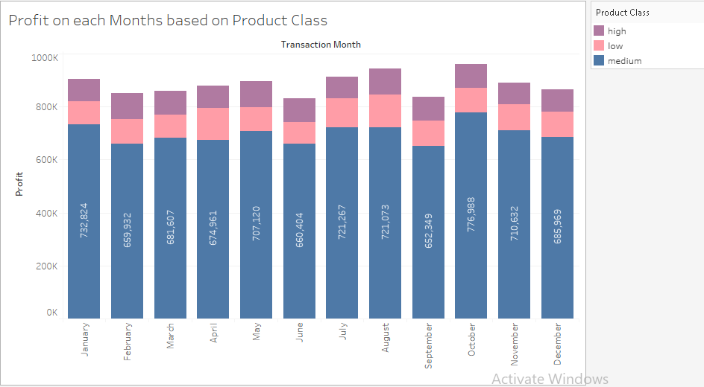
The first analysis was based upon the Profit on each Months based on Product Class.

Slide 4
The last dashboard explains that the product class medium has the highest profit in the month of October.
Its clear that the customers are willing to get medium class products than lower and high class products.
This can also conclude that there would be many people belong to middle class.
The higher and lower class products profits are nearly the same as we can infer from the dashboard.

Slide 5
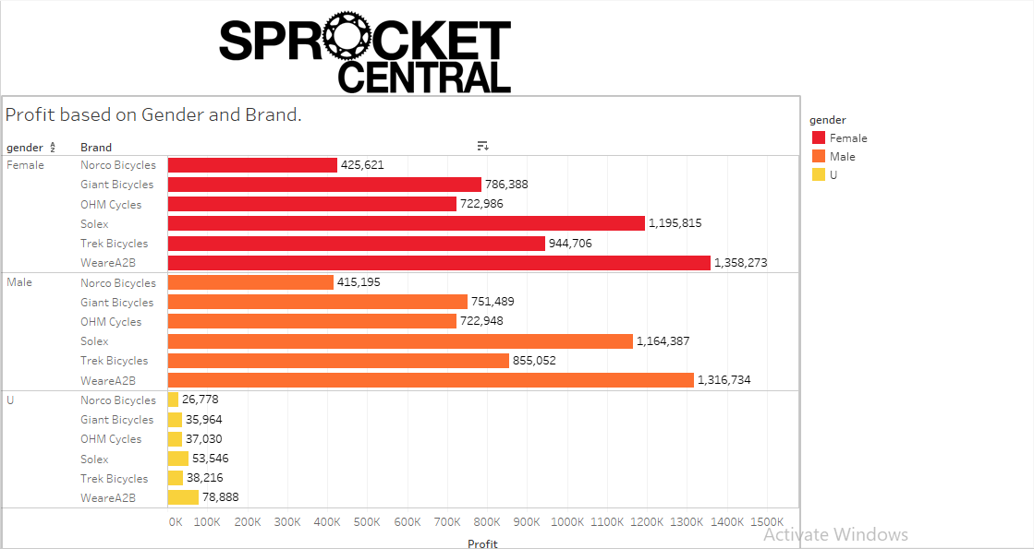
2. The second analysis is based on the Profit based on Gender and Brand.

Slide 6
We conclude from the above dashboard that the brand WeareA2B brand has been widely sold in all the categories of Gender.
The highest profit is obtained by the WeareA2B under the female category.
The lowest profit was acquired by Norco Bicycles in all of the categories.
The sales of the Norco Bicycles can be improved by providing some offers which will make the customers to prefer Norco Bicycles as there 1st preference. Also, It is suggested that to release a new product as per the customer choice and feedback.

Slide 7
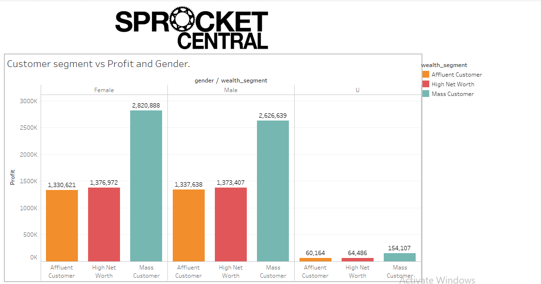
3) The dashboard is based 0n Customer segment vs Profit and Gender.

Slide 8
The wealth segment consists 3 categories namely:
Affluent Customer
High Net Worth
Mass Customer
As per the analysis performed the Mass customer wealth segment has particularly performed well in both Male and Female category.
Also the High net worth and affluent customer has been equally doing well in both of the Male and female category. Since the gender category has very low number of customers it is widely ignored in some cases.

Slide 9
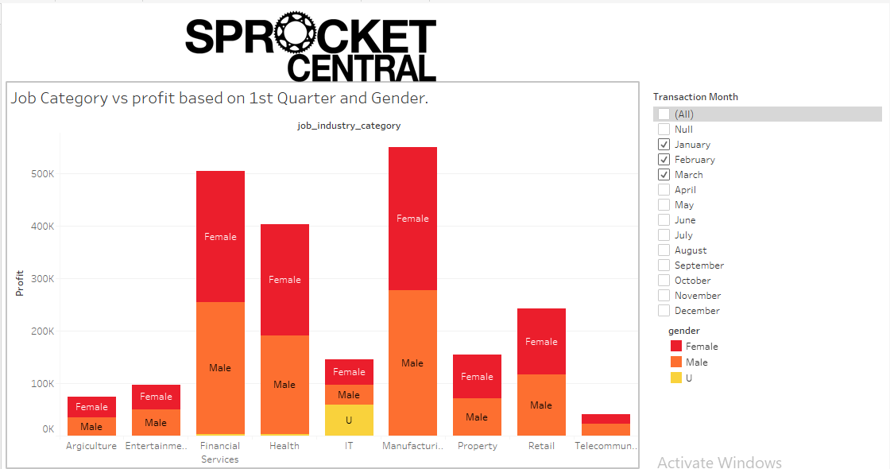
4) The next analysis is based on the Job Category vs profit based on Gender in which the analysis has been done in 4 separate quarters.
1.

Slide 10
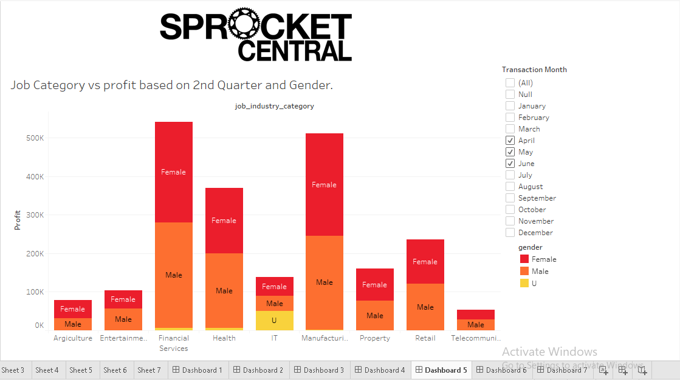
2.

Slide 11
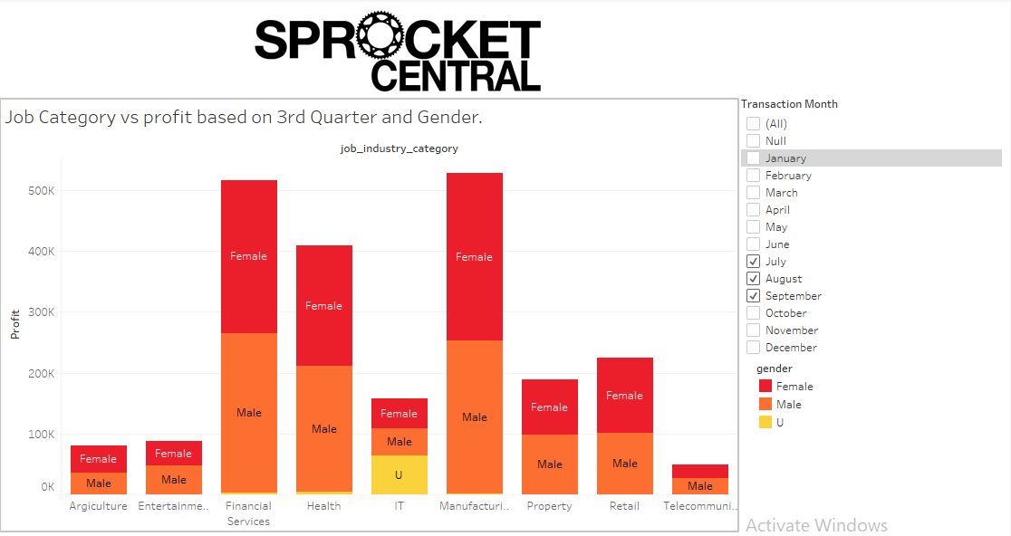
3.

Slide 12
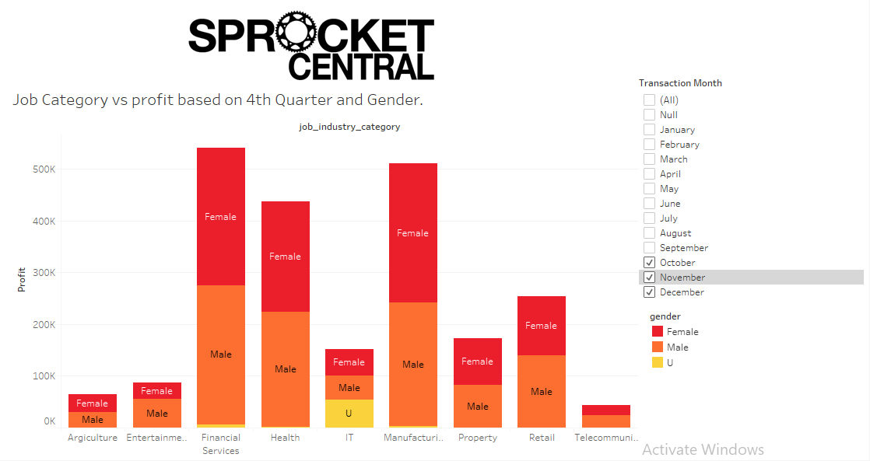
4.

Slide 13
The job category Financial services and manufacturing are the top two category top are performing well as per the analysis.
In the 1st quarter the manufacturing category has performed well and in the 2nd quarter Financial services has performed. Now we can say that the observations is up and down between the categories Financial services and manufacturing.
As we have seen the dashboard the Agriculture and telecommunication has been underperforming in case of both Male and female categories.
With the help of other categories such as IT, financial services etc. could help the agriculture and telecommunication categories to improve rapidly.

